Slide 1



DISTRIBUTIONS & ERROR BARS
Knowledge and solutions for a changing world
Advancing data-intensive discovery in all fields
Be boundless
UW DIRECT
(Data Intensive Research Enabling Cutting-edge Tech)
https://uwdirect.github.io
Stéphanie Valleau
Chemical Engineering

Slide 2
Announcements
Ken Yashura from the Office for the Advancement of Engineering Teaching & Learning ET&L will be taking the first 20min of lecture on Thursday 01/28/2021 to assess the class
Please participate – your feedback is fundamental to us! It helps us understand what works and what does not work with the class
We will not be present during the evaluation – your feedback is confidential
Lecture will start right after the evaluation.

Slide 3
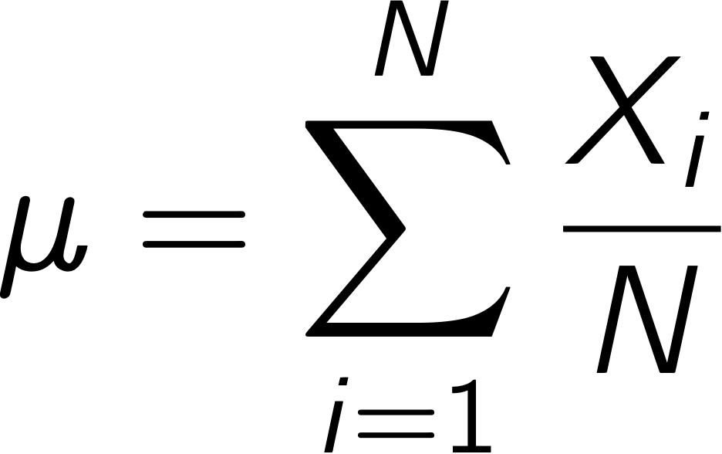
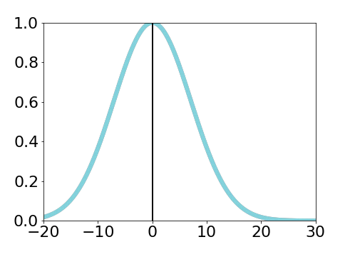
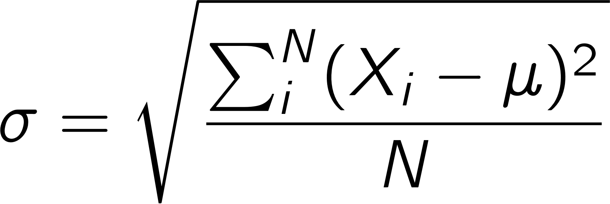
Review
Population mean and standard deviation
Population and Sample, X
Sample mean and standard deviation
Median, mode and variance
Sampling Bias
Sampling with/without replacement
Bootstrapping (we will see this in a few lectures)

Slide 4
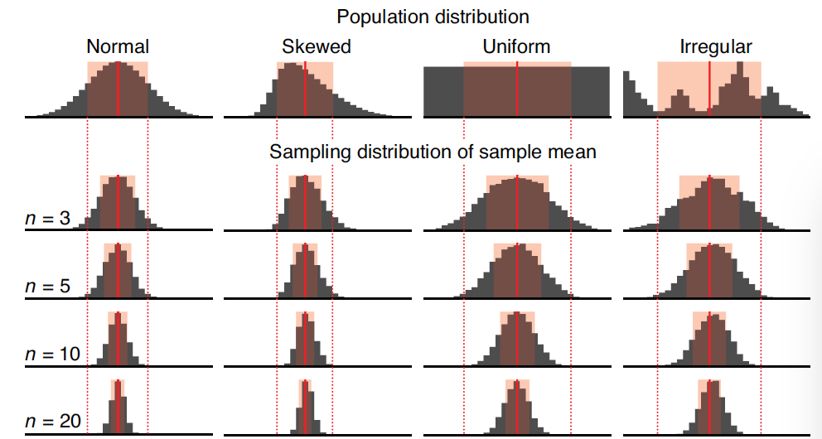
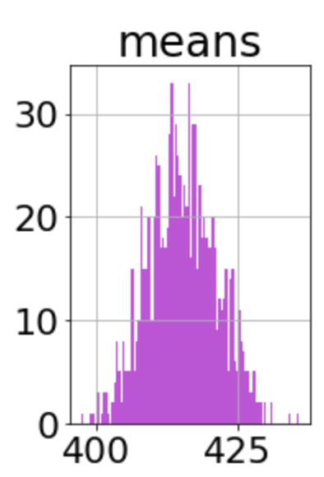
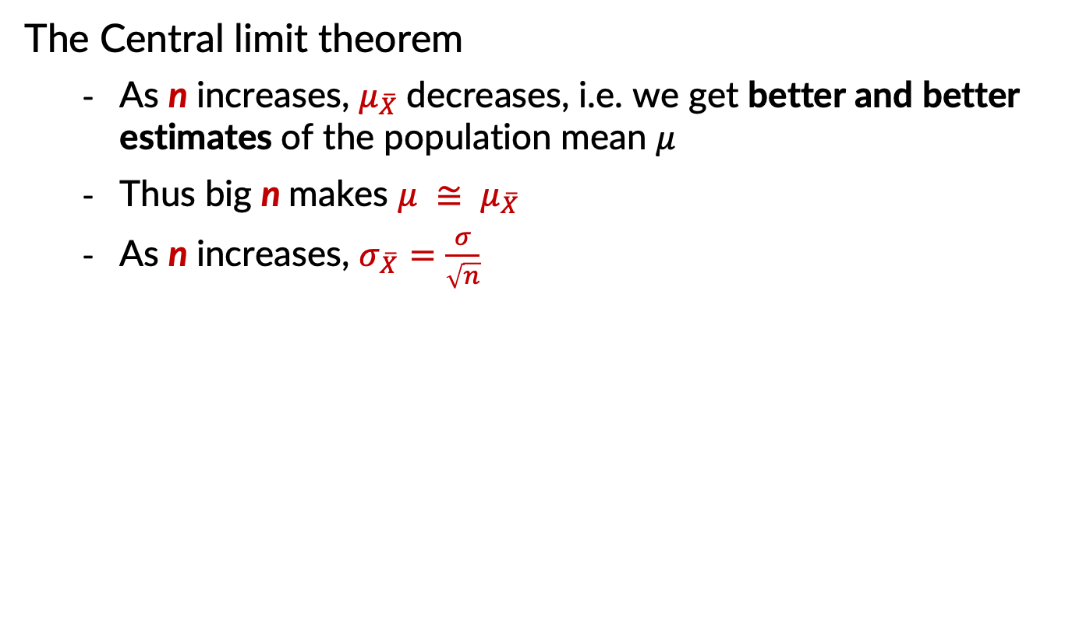
Review
The Central limit theorem
As n increases, $μ_{\overline{X}}$decreases, i.e. we get better and better estimates of the population mean 𝜇
Thus big n makes $μ ≅ μ_{\overline{X}}$
As n increases, $σ_{\overline{X}}=\frac{σ}{\sqrt{n}}$
Nature, 2013. Importance of being uncertain

Slide 5
Outline
Continuous vs Discrete random variables
Common PMF and PDF distributions and their uses
Error bars
The cumulative distribution function, CDF
Sampling from distributions using the inverse CDF

Slide 6
Continuous random variable
A continuous random variable can take any value, bounded or unbounded
Some examples?
You measure the weight of a new hydroscopic substance you have developed hourly for a week

Slide 7
Discrete random variable
A discrete random variable can only take certain values, e.g. integers
Some examples?
Flip a count n times and count the number of heads. What is n?
What is the range of values for the number of heads?
Can you get n/2 heads? n/3 heads?

Slide 8
Continuous vs Discrete
Discrete random variables have discrete probability distributions
Continuous random variables have continuous probability distributions
What is a probability distribution?

Slide 9
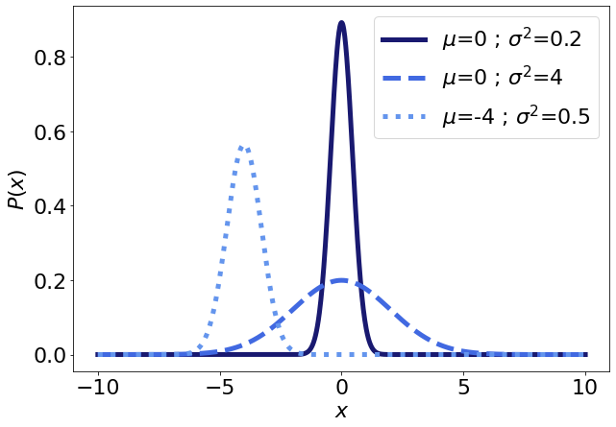
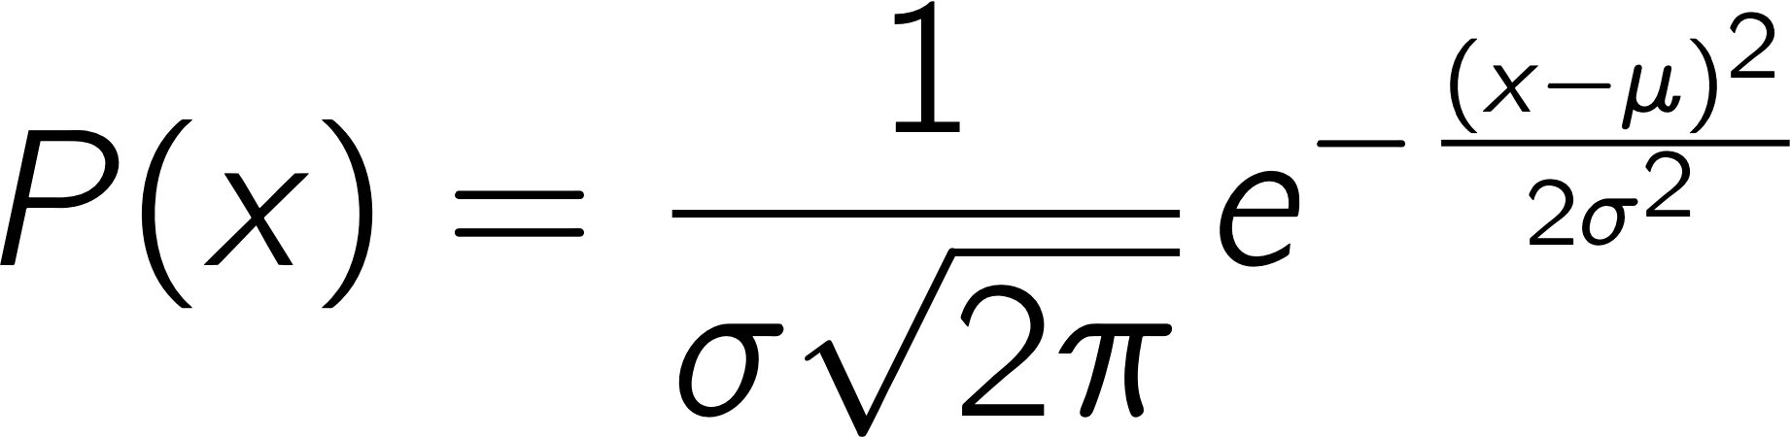
Probability distributions
For a given distribution, the probability distribution function P(X) is the probability of drawing the value X from the distribution
Normal distribution

Slide 10
Probability distributions
For continuous random variables the probability distribution is usually called the probability density function (PDF).
For discrete random variables the probability distribution is usually called the probability mass function (PMF).
What could this be a PMF of?
http://tinyurl.com/yattghb7

Slide 11
Discrete distrib. – Binomial
The binomial distribution can be used to describe the behavior of a random variable X if
number of observations n is fixed
each observation is independent
the outcome of each observation is boolean - (“yes” or “no”, "success" or "failure”, “true” or “false”)
probability of "success" p is the same for each outcome
Binomial coefficient
Probability that X = k
Probability of failure q = 1 – p

Slide 12
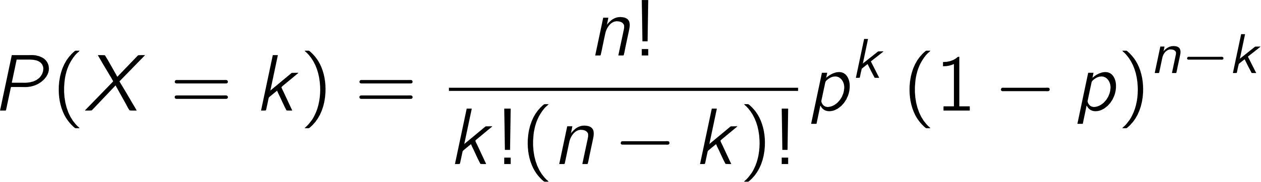
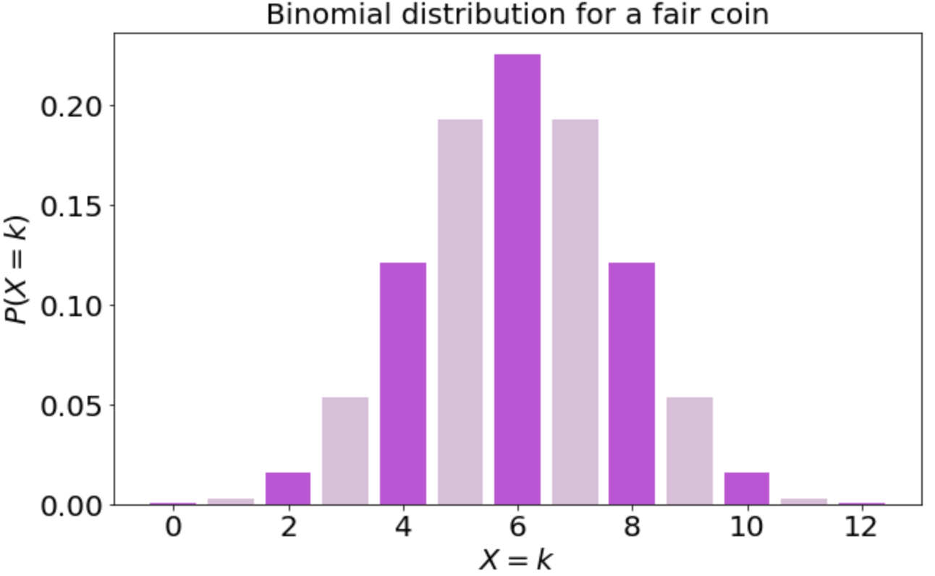
Binomial distribution
n = 12
p = 0.5
q = (1 - p) = 0.5

Slide 13
Discrete distrib. – Poisson
The Poisson distribution can be used to describe the number of occurrences, k, of an event - random variable X - if
k number of times an event occurs in an interval – can take values 0, 1, 2, ....
events occur independently
average rate at which events occur is independent of any occurrences - usually assumed to be constant
two events can’t occur at exactly the same instant
Siméon Denis Poisson
1781 –1840
https://en.wikipedia.org/wiki/American_butterfish
https://en.wikipedia.org/wiki/Sim%C3%A9on_Denis_Poisson
Notes:
P(X=k) = \frac{\lambda^k e^{-\lambda}}{k!}
\lambda = \mu_{\sf poisson} = E(X)

Slide 14
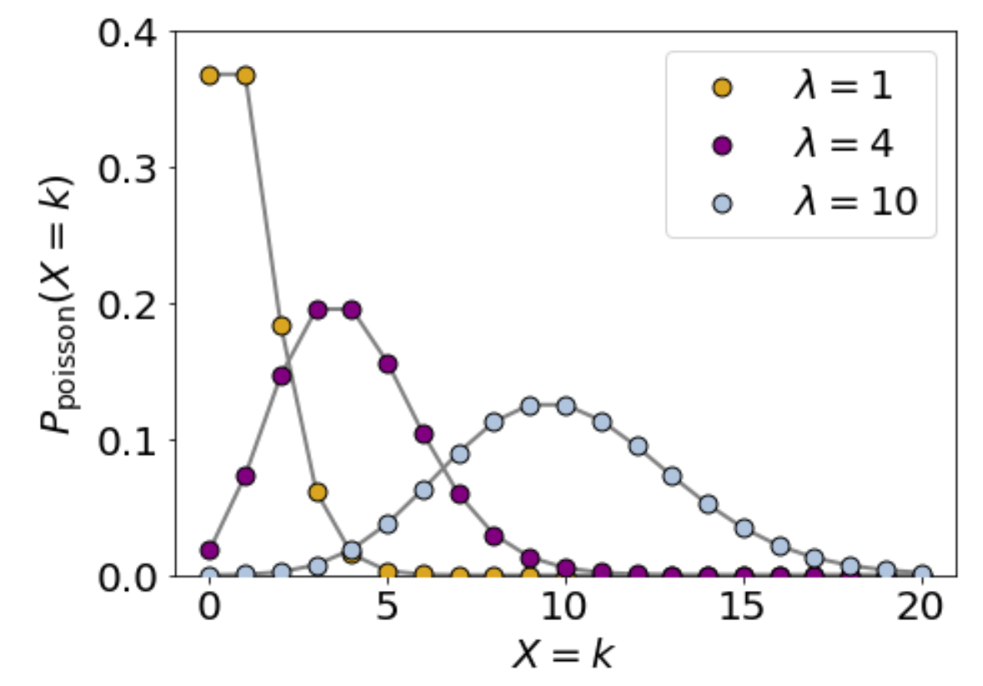
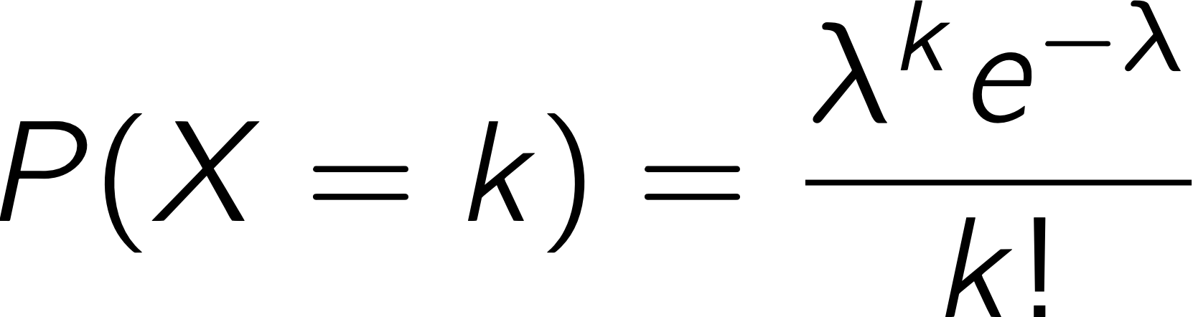
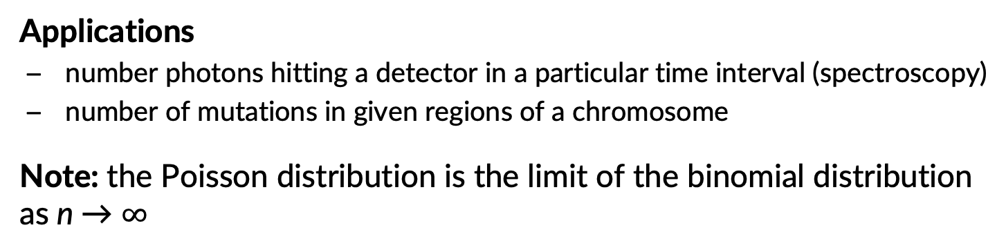
Poisson distribution
Applications
number photons hitting a detector in a particular time interval (spectroscopy)
number of mutations in given regions of a chromosome
Note: the Poisson distribution is the limit of the binomial distribution as n → $∞$

Slide 15
Distributions & Error bars
Error bars give you a measure of the accuracy of a measurement, calculation or inferred estimate of a quantity
SD Standard deviation respect to the mean value (discrete distribution)
SE / SEM Standard error of mean
CI Confidence interval
Error bars in experimental biology https://rupress.org/jcb/article/177/1/7/34602

Slide 16
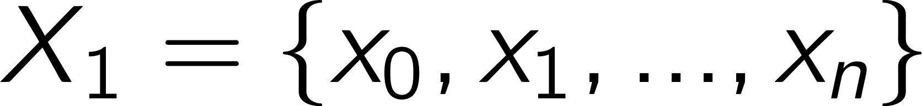
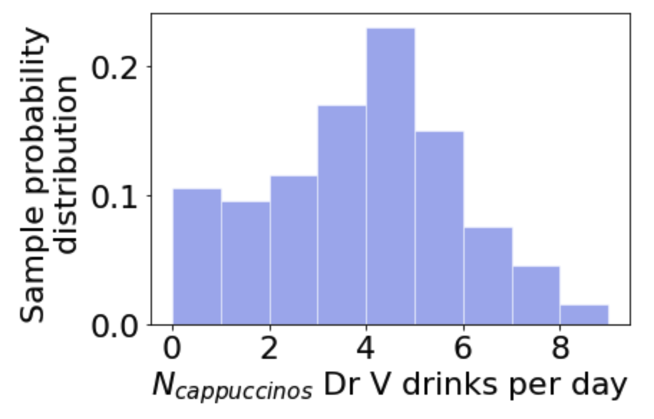
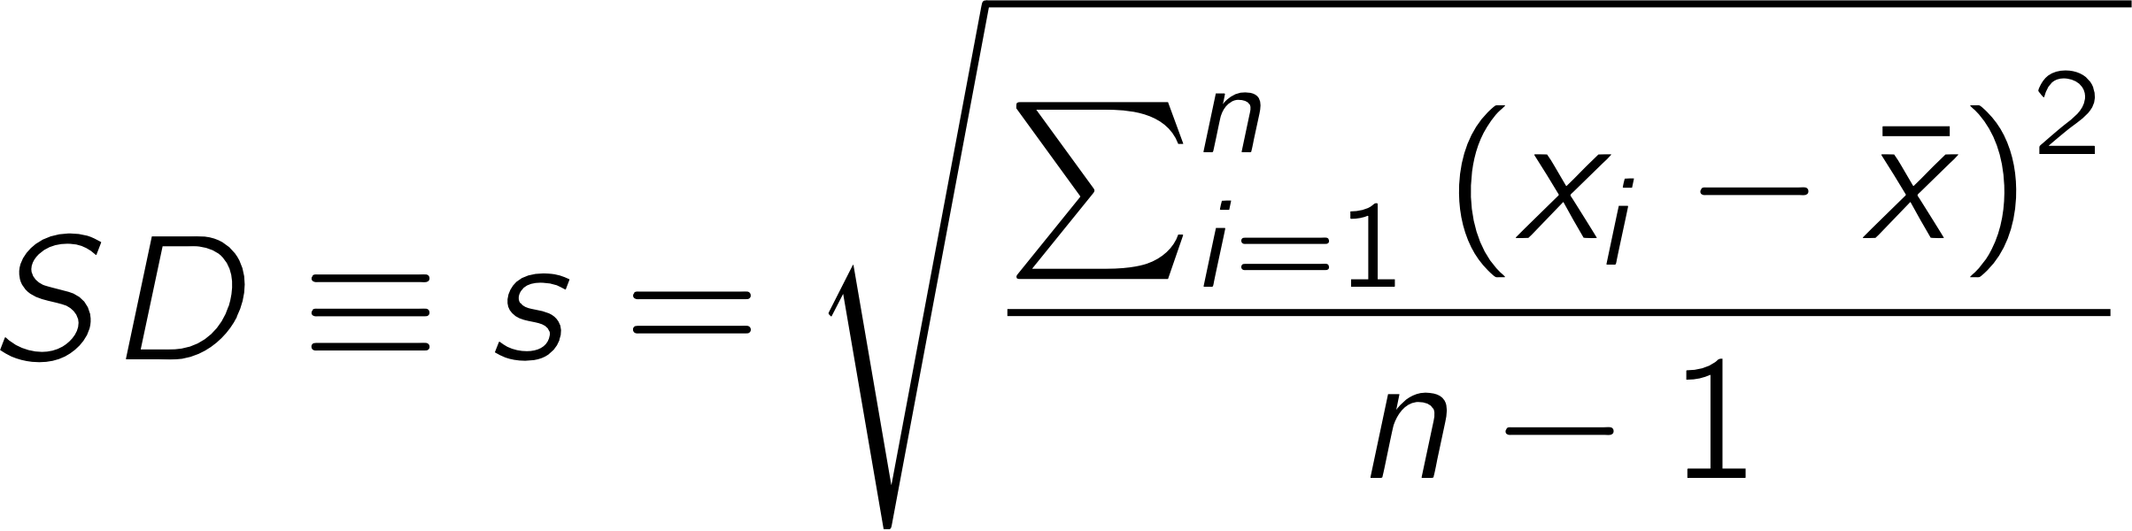
Standard deviation
Sample of number of cappuccinos Dr V drinks per day
Standard deviation
descriptive error bar
the smaller SD the better
larger n means more accurate estimate of SD – get closer to SD of population
Notes:
SD \equiv s = \sqrt{\frac{\sum_{i=1}^n\left (x_i - \bar{x}\right)^2}{n-1}}

Slide 17
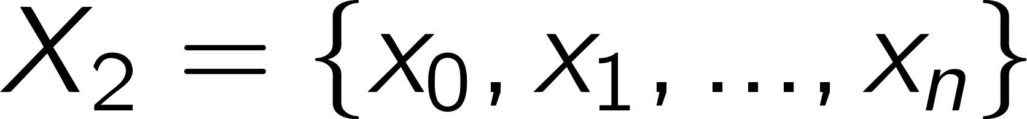
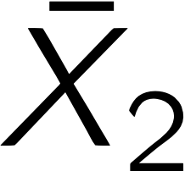
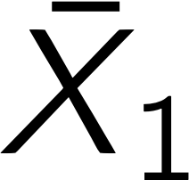
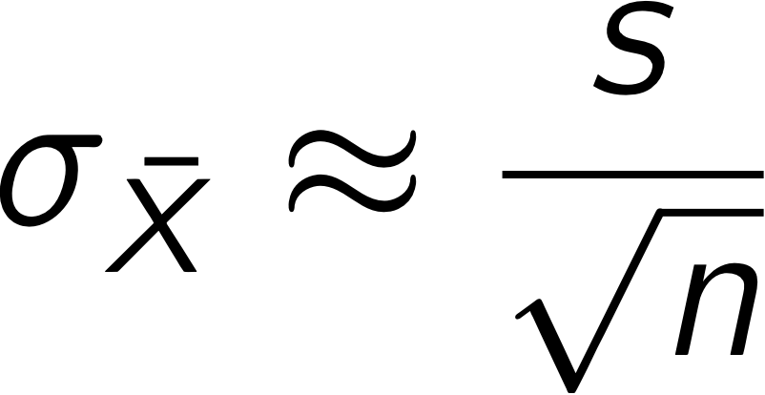
Standard error of mean
Samples of number of cappuccinos Dr V drinks per day
Standard error of mean
Stdev. of sample
inferential error bar
estimate of variation between samples / uncertainty in mean
Notes:
SD \equiv \sigma = \sqrt{\frac{\sum_{i=1}^N\left (x_i - \bar{x}\right)^2}{N-1}}
X_1 = \left\{x_0,x_1,...,x_n\right\}

Slide 18
Confidence Interval (CI)
Confidence interval error bars tell us about the reliability of the measurement.
We will get back to confidence intervals after we talk about hypothesis testing and p-value.
Confidence intervals. Means and 95% CIs for 20 independent sets of results, each of size n = 10, from a population with mean μ = 40 (marked by the dotted line). In the long run we expect 95% of such CIs to capture μ; here 18 do so (large black dots) and 2 do not (open circles). Successive CIs vary considerably, not only in position relative to μ, but also in length. The variation from CI to CI would be less for larger sets of results, for example n = 30 or more, but variation in position and in CI length would be even greater for smaller samples, for example n = 3.
Error bars in experimental biology https://rupress.org/jcb/article/177/1/7/34602

Slide 19
Let’s see PMFs in Jupyter!
Open the L4_Distributions.ipynb notebook

Slide 20
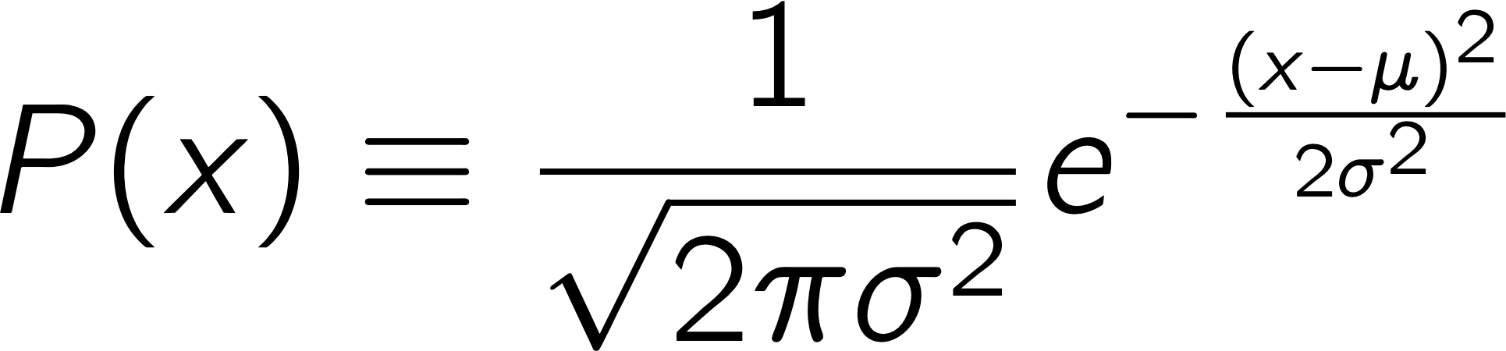
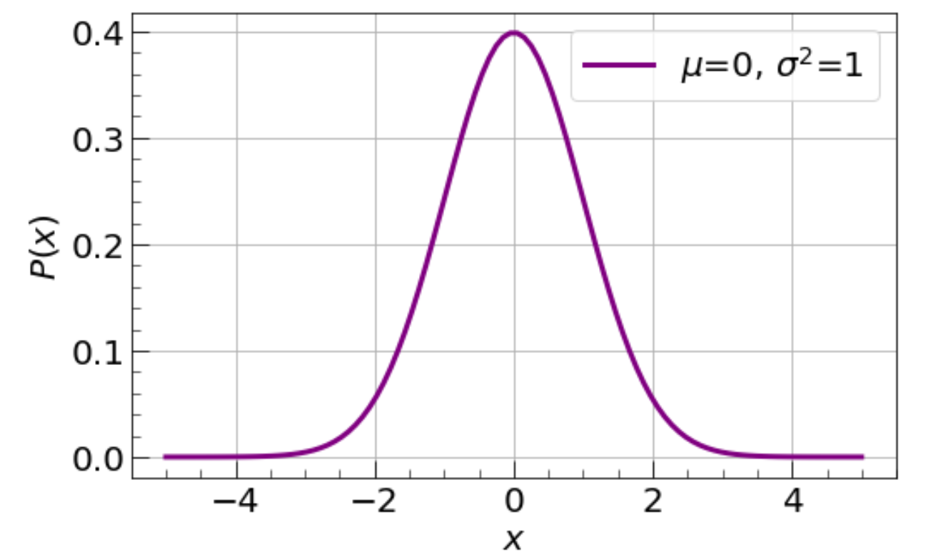
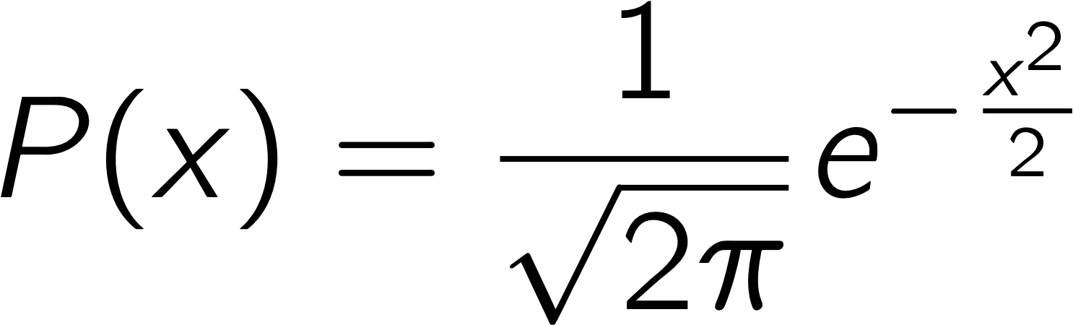
Continuous distrib. – Normal
Normal distribution
Standard normal distribution
mean = 0 & std. dev. = 1
Notes:
P(x) \equiv \frac{1}{\sqrt{2 \pi \sigma^{2}}}e^{-\frac{(x-\mu)^{2}}{2\sigma^{2}}}
P(x) \equiv \frac{1}{\sqrt{2 \pi}}e^{-\frac{x^{2}}{2}}

Slide 21
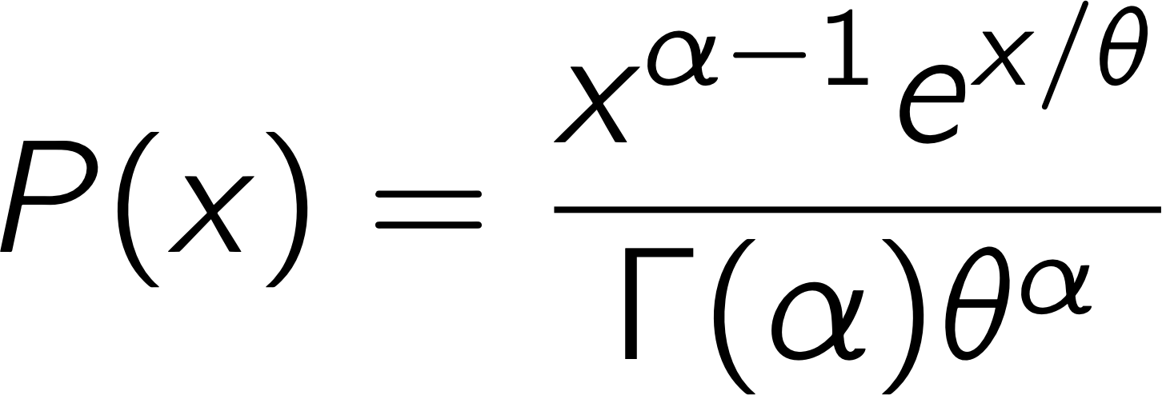
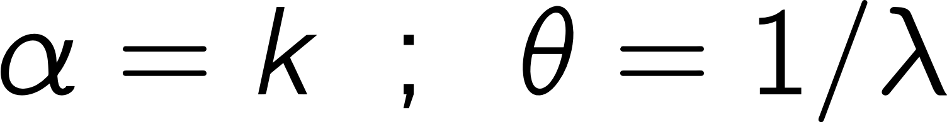
Continuous distrib. – Gamma
The gamma distribution describes the distribution of waiting times until the next k-th Poisson distributed occurrence
E.g. Consider a spectroscopic experiment that collects a set of single molecule data: individual times between chemical reactions (i.e., the inverse of a reaction rate)
shape
scale
https://en.wikipedia.org/wiki/Gamma_distribution
Notes:
P(x) = \frac{x^{\alpha - 1}e^{x/\theta}}{\Gamma(\alpha)\theta^\alpha}

Slide 22

Cumulative distribution function (CDF)
Probability distribution functions PDF, PMF: probability of drawing a sample with a value X
Cumulative distribution function (CDF) is the probability of drawing a value from the distribution less than x.
Notes:
F_X(x) = \sum_{i=0}^{\left\lfloor k \right\rfloor
}P(X=i)

Slide 23
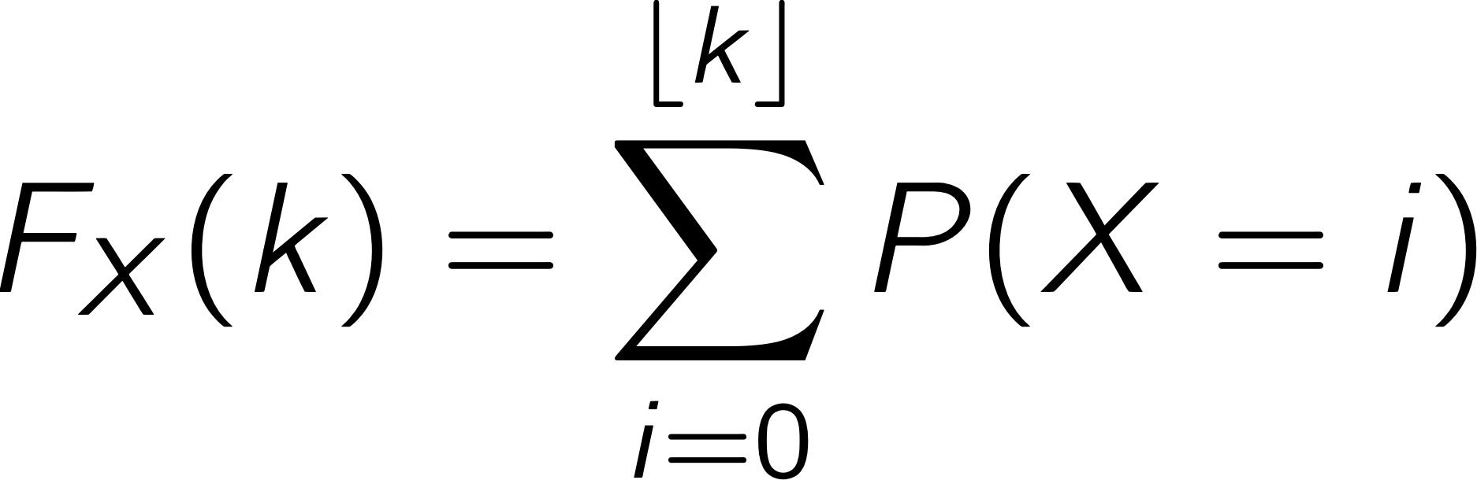
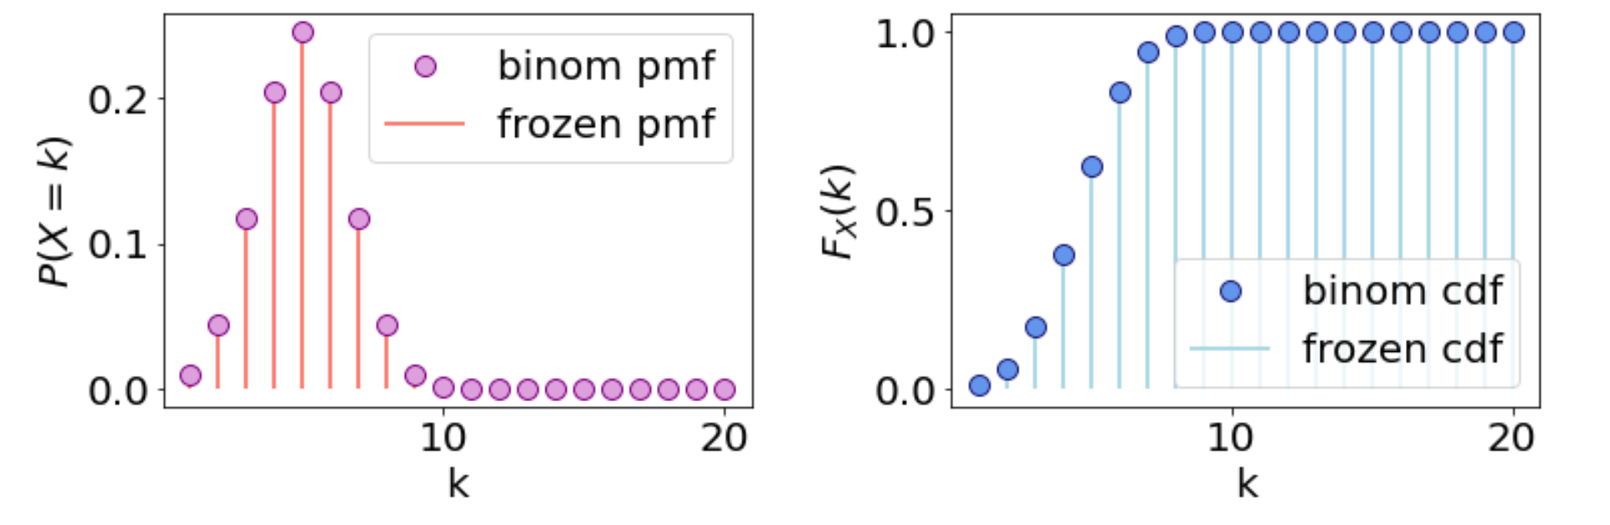
Binomial CDF
p = 0.5 ; n = 10
PMF
CDF

Slide 24
Poisson CDF
PMF
CDF

Slide 25
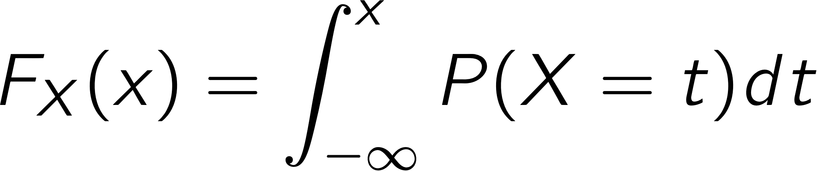
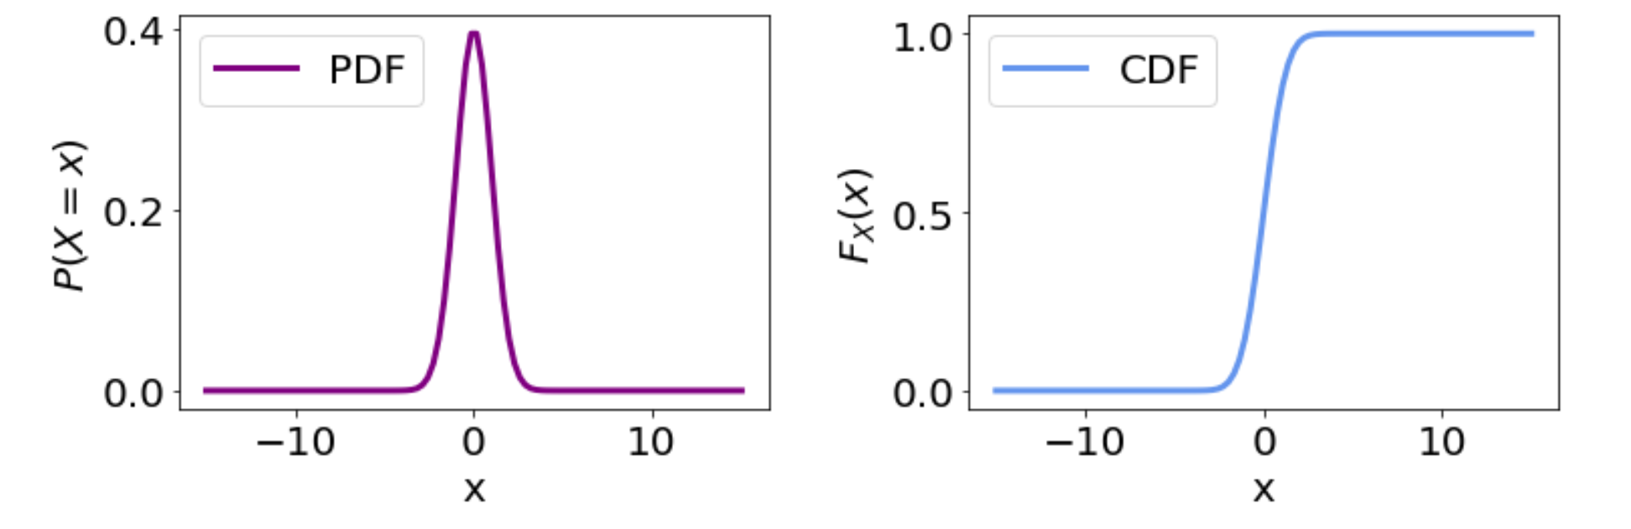
Cumulative distribution function (CDF)
For a continuous distribution, F(x) is the integral of the PDF.
PDF
CDF
https://en.wikipedia.org/wiki/Normal_distribution

Slide 26
CDF’s in Jupyter
Let’s go back to the notebook!

Slide 27
Cumulative distribution function (CDF)
Why is the CDF useful?
E.g. survivability? What fraction of your mice are dead by day x?

Slide 28
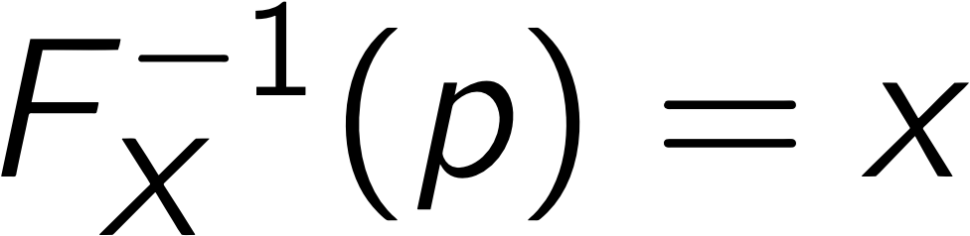
CDFs & distribution sampling
You can sample from a distribution using its CDF this approach is known as inverse transform sampling
p is uniformly distributed – you can sample points from a uniform distribution and use the inverse CDF to sample points from the PDF
https://en.wikipedia.org/wiki/Probability_integral_transform

Slide 29
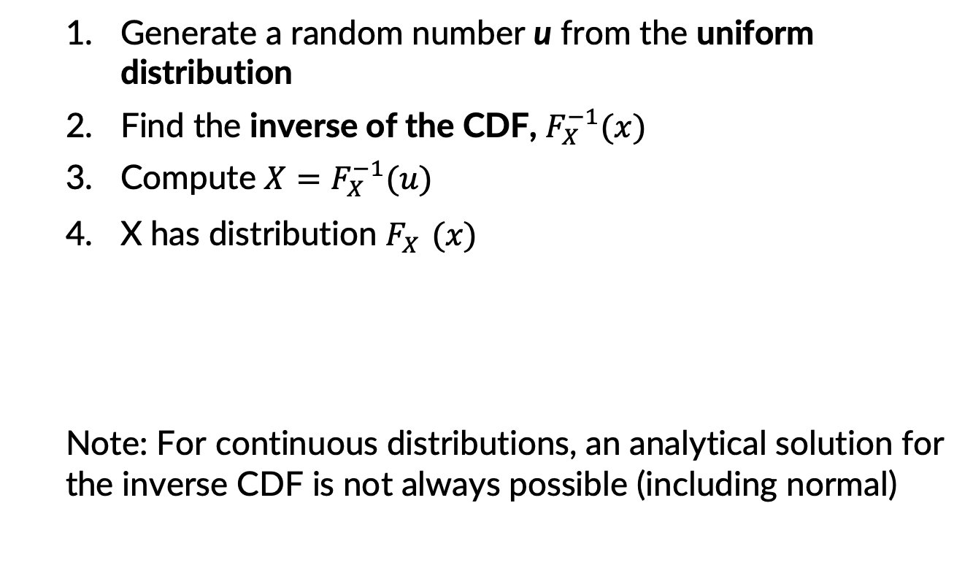
Inverse transform sampling
Generate a random number u from the uniform distribution
Find the inverse of the CDF, $F_{X}^{−1}(x)$
Compute ${X=F}_{X}^{−1}(u)$
X has distribution $F_{X}^{}(x)$
Note: For continuous distributions, an analytical solution for the inverse CDF is not always possible (including normal)

Slide 30
Sampling from distrib. in Python!

